Slide 1
Add title
Lifeline
Notes:
(This presentation is designed for educators to use in their own way. It takes approximately an hour to present, but some slides may not be relevant to the group you are presenting to so there is a function in powerpoint to hide these slides from general view rather than eliminating them in total. That way, you have all the slides and can pick and choose from them rather than trying to find slides in your own documents folder on your computer. Feel free to add your own slides or make changes to images and or formatting.

Slide 2
LEARNING OUTCOMES
An understanding of the services that Natural Fertility New Zealand offers
An understanding of what Fertility Awareness is and its value to the client
www.naturalfertility.co.nz
Notes:
These are generic learning outcomes. The person who contacted you about the session may have more specific outcomes they would like you to address. Make sure you are both on the right page before the presentation date, but also check in on the day with attendees (if possible and appropriate) if there is any questions they would like specifically answered. These can be written up on a whiteboard for you to check throughout and at the end of the session that they have been covered or put onto a piece of paper and glue tacked up onto a wall.
‹#›

Slide 3
Notes:
Allow participants to read the cartoon. “We can joke about this, but people in general have little understanding about their fertility, menstrual cycle or conception.”

Slide 4
Fertility Quiz Answer true or false to the following questions
Men are only fertile for about two weeks out of every month
A woman who has irregular periods is less likely to get pregnant
Sperm live for as long as it takes to meet the egg
A woman cannot get pregnant if she has intercourse during her period
Women are most likely to ovulate two weeks before their period
After ovulation the woman’s egg lives for about 3 days
After menopause, women don’t ovulate at all
You can always tell when your next period is due if you know when you ovulated
A woman can ovulate twice during her menstrual cycle
If a woman is breastfeeding, she cannot get pregnant
Notes:
You can get participants to number a piece of paper 1-10 and answer true or false to the questions, read the questions out loud and get people to give their answer, or have the questions on a preprinted card or paper, divvy them out to the group and get them to go round one by one, read out their statement and get them to place the answer next to a true or false card on the floor or blue tacked to a wall/whiteboard. If people don’t agree with the answer, they can move it to true or false and give their reasoning. If you get people to do this individually on paper, you can either go through the answers there and then, or wait till the end of the session and go through the answers (the last slide of this presentation has the answers).

Slide 5
Natural Fertility NZ
Founded in NZ in 1974 as Natural Family Planning
Rebranded in 2002 as Natural Fertility NZ
Not for profit organisation and a registered charity with DIA
Supported by an independent Medical Scientific Advisory Board
Accredited educators in clinics throughout NZ
Offer Distance Learning, Web Sessions and Skype Consultations
Education in schools, with community groups and health professionals
MOU with Family Planning and Parents Centre
www.naturalfertility.co.nz
Notes:
Go through this slide.
In 2002 rebranded from Natural Family Planning to Natural Fertility NZ. In the past there had been a lot of confusion between what Family Planning did and what Natural Family Planning did.
DIA (Department of Internal Affairs)
MOU - Memorandum of understanding (a formal written agreement), where both these organisations and NFNZ accept and agree that each organisation are the experts in their fields.

Slide 6
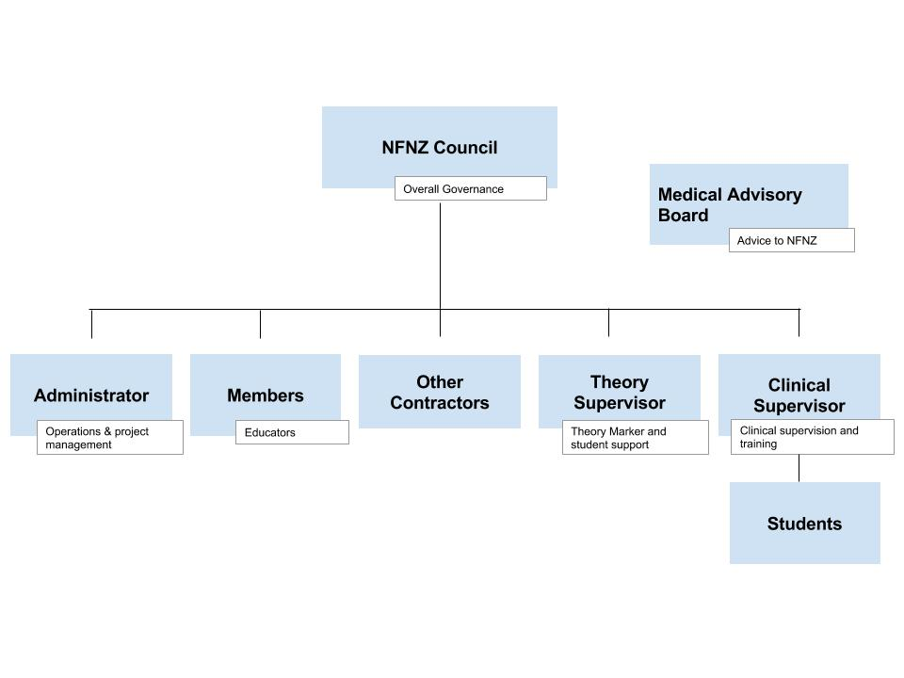
Notes:
Main theme here is that we have a very flat structure. Our Council and MSAB (Medical Scientific Advisory Board) are unpaid. MSAB role is to offer expert opinion on new research around NFP that is brought to their attention by the Clinical Supervisor and to support the Clinical Supervisor in answering complex medical questions that he/she requires input on.

Slide 7
MISSION STATEMENT
To be recognised as the authority on fertility awareness and natural family planning in New Zealand
www.naturalfertility.co.nz
Notes:
This is our Mission Statement.

Slide 8
World Health Organisation:
Natural Family Planning is defined as a method of fertility regulation by which, with reference to the natural physiological manifestations of the fertile and infertile phases of the menstrual cycle, the couple can time and/or abstain from sexual intercourse according to their desire to achieve or avoid a pregnancy.
The Sympto-thermal method of Natural Family Planning offers a 98% effective method of family planning. The effectiveness of the method is reduced when barriers or devices are introduced.
www.naturalfertility.co.nz
Notes:
The World Health Organisation defines Natural Family Planning in the following way…. Let participants read it. “That sentence can sound rather complex, but what it is simply saying is that by recognising her signs of fertility, a woman can time or abstain from intercourse to meet her individual goals which might be ‘to conceive’ or ‘to avoid pregnancy’. The Sympto-Thermal method is the most effective of the Natural Family Planning Methods - giving couple 98% protection from an unplanned pregnancy. The method requires some very basic recording of signs of fertility and Basal Body Temperature.

Slide 9
Health Education
Individuals/Couples
Groups
Notes:
Natural Fertility Educators provide health education to individuals, couples and various groups. We will go into each of these in more detail.

Slide 10
Individuals and Couples
Notes:
Let's now have a look at how we work with individuals and couples.

Slide 11
Those interested in learning about their fertility include: those wanting to conceive those wanting a natural form of contraception those wanting to learn more about their fertility and menstrual cycle
Notes:
So individuals/couples use our service for various reasons. It may be for help in conceiving; wanting to use a non chemical form of contraception; or simply to learn more about their fertility and menstrual cycle. They may, or may not be sexually active. They may suffer from migraines and want to track which part of the cycle they occur in so that they can isolate the hormone responsible and treat appropriately. The client may have had a recent diagnosis of Polycystic Ovaries or Endometriosis and they want to see what if any effect it is having on their cycle and fertility.

Slide 12
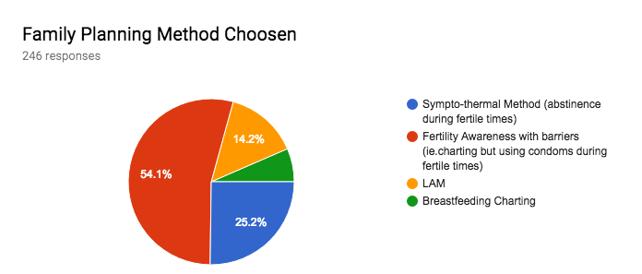
NFNZ Clients (2015-2017)
Notes:
For those clients seen by a NFNZ Fertility Educator for contraception in 2015-2017 we can see that:
54.1% chose Fertility awareness with barriers
25.2% for Natural Family Planning (abstinence during fertile times).
14.2% used LAM (Lactational Amenorrhea Method - for fully breastfeeding mothers).
6.5% used Breastfeeding charting
‹#›

Slide 13
What do Fertility Educators teach?
The scientifically based Sympto-Thermal
and
Lactational Amenorrhoea methods
of
Natural Family Planning.
Notes:
These are the two methods we teach at Natural Fertility NZ. The one we are going to focus on today for you is……(whatever was decided by you and the coordinator of the group). Covering both in one session is too much.
‹#›

Slide 14
Both methods are approved by the World Health Organisation and are at least 98% effective for those choosing to avoid pregnancy. The Sympto-Thermal method increases a couples chance of conception in the first year by targeting the most fertile time.
Notes:
If you were to Google Sympto-Thermal method and Lactational Amenorrhea Method you would find many links to many research articles. The World Health Organisation states that both these methods are at least 98% effective in avoiding pregnancy.
If you are wanting to maximise your chances of conceiving, by using targeted intercourse with your most fertile time, your chance of conception increases from the general stats of 80% in the first year to 92%

Slide 15
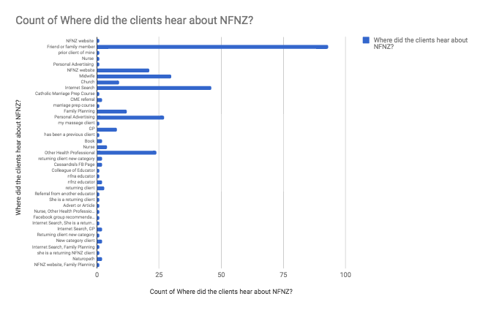
Notes:
You might be wondering where do our referrals come from? As you can see from this slide, the majority are from friends or family who have had a positive experience from the service in the past - good old word of mouth, followed by internet searches for services and a variety of health professionals. (You may want to mention about your own stats in here).
‹#›

Slide 16
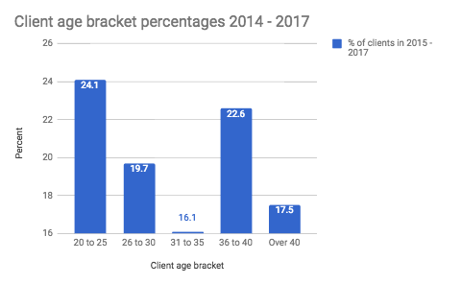
Notes:
This graph shows the age of those seeking Fertility Awareness information from 2014 to 2017.
20 - 25 year olds are the biggest group that we currently see at NFNZ. Over the last ten years our clients have become slightly younger with a 2010 peak in the 30-34 year old age group. Prior to that our largest group was 35-39 years in 2005/2006

Slide 17
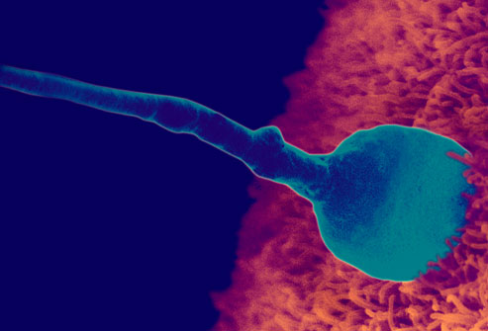
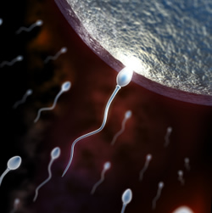
Notes:
Isn’t everyone aware of their own fertility? Isn't it as simple as ‘sperm meets egg’?
We make assumptions that people know how their bodies work. We assume that the basics such as the menstrual cycle, male and female reproduction and fertility have been taught at school, somewhere along the line. People understand that unprotected intercourse can result in STIs and unplanned pregnancy but my experience shows me that they understand little beyond this.
In today’s society, anything and everything is Googled and that includes information on fertility and the menstrual cycle. Unfortunately, it is difficult for the consumer to discern fact from fiction and ascertain the credibility of the website they are using. It it’s on the net - it must be true mentality tends to prevail.
There is a lot of misinformation out there which can include: all women ovulate on day 14 of their cycle, all women have a 14 day luteal phase, if a woman has irregular cycles she will have trouble conceiving or can’t use Fertility Awareness for natural contraception.

Slide 18
Fertility Awareness In Women Attending a NZ Fertility Clinic
80 subjects were surveyed for knowledge of their fertility: recognition of fertile symptoms, what the symptoms mean and how this information was used to enhance chances of conception
46% of the women surveyed had NO UNDERSTANDING of their fertility
Only 26% of women had ADEQUATE understanding
Only 15% consciously timed intercourse when their chances of conceiving were optimum
Notes:
There was a study done many years ago in Auckland, NZ, of a small group of women attending a tertiary fertility clinic, to ascertain what their level of understanding was about their fertile signs in regard to trying to conceive. Read the bullet points….

Slide 19
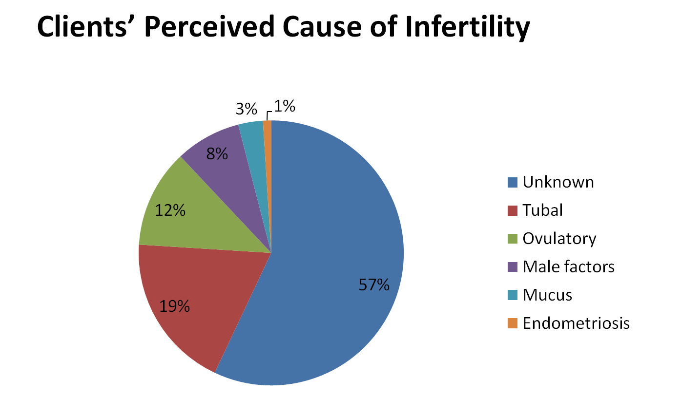
Notes:
This slide shows the clients’ perceived cause of infertility in that study.
Alarmingly, 57% had no idea as to the cause of their infertility.
If this study was repeated today, I would feel fairly confident in saying that the percentage of women affected by Endometriosis would have increased hugely due to better and earlier diagnosis.
‹#›

Slide 20
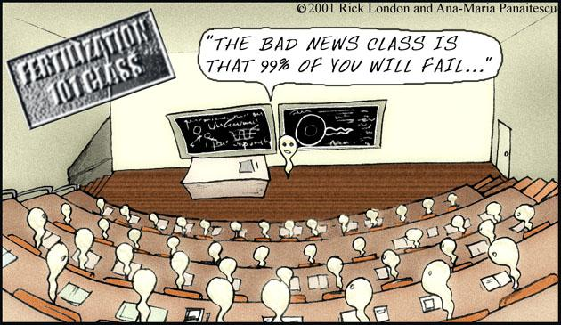
Notes:
Let them read the cartoon.
We encourage our clients to bring to the clinic any test results that they may have in regard to fertility investigations. We can go through these results with the clients so that they understand what is going on. There is also a lot of misinformation around about sperm production, sperm survival, frequency of intercourse, positioning etc. We spend time during the consultation correcting this information.
‹#›

Slide 21
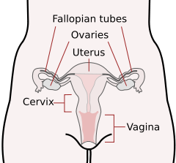
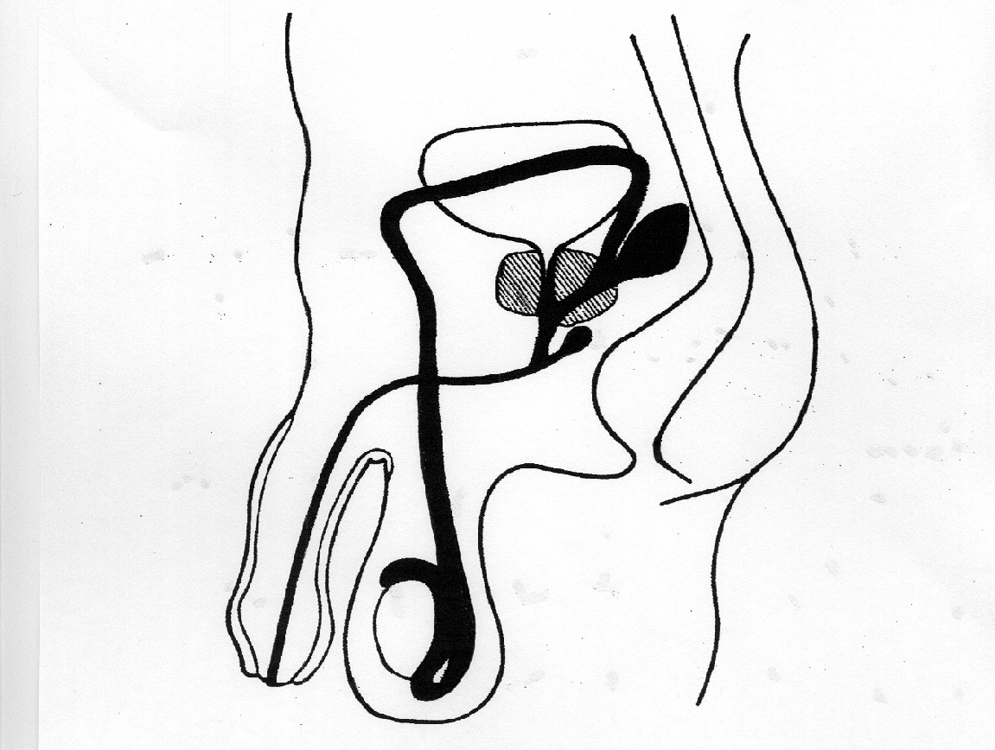
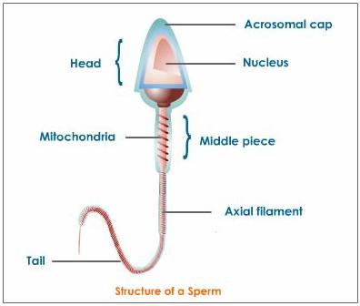
Anatomy and Physiology
Notes:
So, knowing that people know so little information about how their body works we do a basic review of anatomy and physiology.
In the first session we take a health history and give a very basic overview of anatomy and physiology. We make no assumptions about what people know prior to the appointment. This overview also gives educators the opportunity to explain issues specific to that client such as where a biopsy might have been taken during a colposcopy, what happens with an ectopic pregnancy, endometriosis, PCOS, perimenopause and vasectomy reversal. People also arrive at the clinic with a number of misconceptions about their fertility so it is an opportunity to clear these up.
‹#›

Slide 22
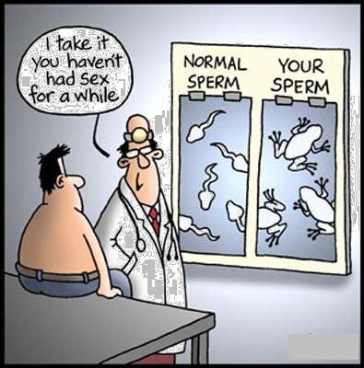
Notes:
Let them read the cartoon. Often, clients are confused about a semen analysis result. Just because someone has an above average number of sperm doesn’t mean the quality is good.
‹#›

Slide 23
COMBINED FERTILITY
Notes:
I want to now move on to talk about combined fertility. We need to understand how a womans and mans fertility combine together to potentially result in conception.
‹#›

Slide 24
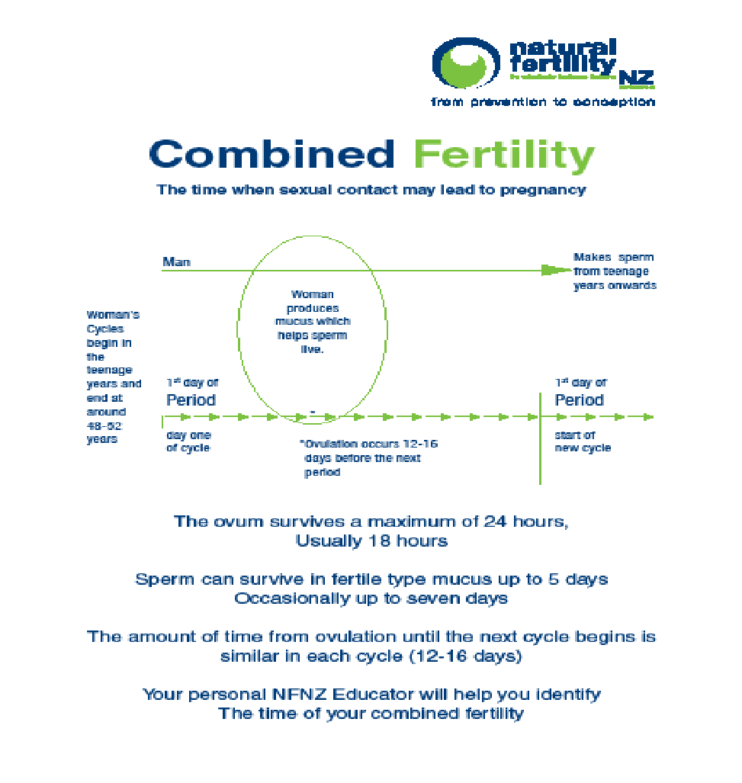
Notes:
Once we have reviewed the anatomy and physiology, we then move on to teach a couple about their combined fertility which is the combination of the factors that make up male and female fertility such as sperm survival, the production of cervical mucus and ovulation. We teach about the luteal phase and address the common misconception that this is 14 days in all women. The medically recognised range is 12-16 days. We also explain to conception clients the rationale behind a day 21 blood test in regards to determining if ovulation has occurred (there is an assumption that ovulation has occurred on day 14, and then wait 7 days for progesterone to peak). Not all women have ovulated by day 21 of their cycle so a day 21 progesterone level can give inaccurate information especially if the client experiences long cycles due to PCOS or being perimenopausal.
‹#›

Slide 25
P O P
Time varies Time is constant
Notes:
This slide here shows that a cycle length starts with the first day of a period (indicated by the first P) and at some point ovulation occurs (release of an egg) and then a new cycle starts with another period. The time between a period starting and a woman ovulating can vary from cycle to cycle due to illness, stress, hormonal factors, some medications. Once a woman has ovulated, the time between ovulation and the next period are relatively constant (there may be a difference of a day or two).
‹#›

Slide 26
Normal Cycle Variation 14 day luteal phase
Period
Fertile CM
Period
Day 1
14
28
Period
Fertile CM
Period
Day 1
9
23
Period
Fertile CM
Period
Day 1
22
36
www.naturalfertility.co.nz
Notes:
This slide shows a woman who has a second phase interval from ovulation to her next period as 14 days. As you can see, even though the day of ovulation can occur earlier or later than usual, the length of the second phase stays the same. It is a good example of showing you how a woman does not ovulate on the same day each cycle.
‹#›

Slide 27
Normal Cycle Variation 12 day luteal phase
Period
Fertile CM
Period
Day 1
16
27
28
12
Period
Fertile CM
Period
Day 1
9
20
21
12
Period
Fertile CM
Period
Day 1
22
33
34
12
www.naturalfertility.co.nz
Notes:
This is a similar slide, showing a woman with a shorter second phase of 12 days. Once again, even though ovulation occurs earlier or later than the first example, the length of the second phase stays the same.
‹#›

Slide 28
The Sympto-Thermal Method
Cervical mucus
Vaginal sensation
Temperature
Cervix
www.naturalfertility.co.nz
Notes:
The Sympto-Thermal method that we teach requires women to be observant about the following signs of fertility: cervical mucus, vaginal sensation, Basal Body Temperature and changes of the cervix. We will talk a little more about these.

Slide 29
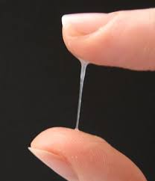
Cervical Mucus
Notes:
Cervical mucus changes throughout a woman’s cycle under the influence of female hormones. After a woman’s period has finished she might notice no mucus or mucus that is very thick or thick. As she gets closer to releasing an egg, the mucus changes to contain a lot more fluid and may be described as stretchy, runny, slippery, thin or watery. This texture makes it easy for sperm to travel through it. Once ovulation has occurred the mucus will go back to being of a thicker texture or may disappear altogether. We ask women to check their mucus just before they urinate, throughout the day, by dabbing or wiping with a piece of toilet paper and noticing the colour, amount and texture. At the end of the day, the woman records on a very simple chart the mucus that had the most fluid content (the most fertile). Vaginal sensation is a sense, without touching of how it felt around the entrance of the vagina throughout the day. This may be described as dry, damp, moist or wet.

Slide 30
Basal Body Temperature (BBT)
BBT charts determine if ovulation has occurred and when it occurred.
Research shows that although not perfect, BBT is a reliable marker of ovulation
It remains a simple, inexpensive method to determine ovulation
Valuable in the detection of onset of progesterone rise, determining duration of luteal phase and timing of various tests
www.naturalfertility.co.nz
Notes:
Temperature is taken first thing on waking in the morning, under the tongue. This is the Basal Body temperature. It is recorded on the chart each day. Once ovulation has occurred, large amounts of the hormone progesterone are produced and this affects a woman's basal body temperature, by increasing it. This increase can be seen on a chart and ovulation can be pinpointed. Because of this we can also establish the length of the second phase of a woman’s cycle (called the luteal length). It needs to be a certain length to help with egg implantation for those wanting to conceive, helps women who are using this information to predict when their next period is due and is useful in the timing of certain tests or investigations.

Slide 31
Cervical Changes
Notes:
A woman’s cervix position and its texture changes throughout a cycle and woman can be taught to notice these changes. This is checked once a day by inserting one or two fingers into the vagina to observe how high or low the cervix is sitting, how open or closed the dimple is (os) and how soft or hard the cervix feels. Low, hard and closed are infertile signs and high, soft and open are fertile signs. The position and texture of a woman’s cervix begins to change 4-5 days before ovulation (it starts to rise (more difficult to reach), becomes softer and the dimple opens). After ovulation, the cervix quickly resorts to being in an infertile state: low, hard and closed.

Slide 32
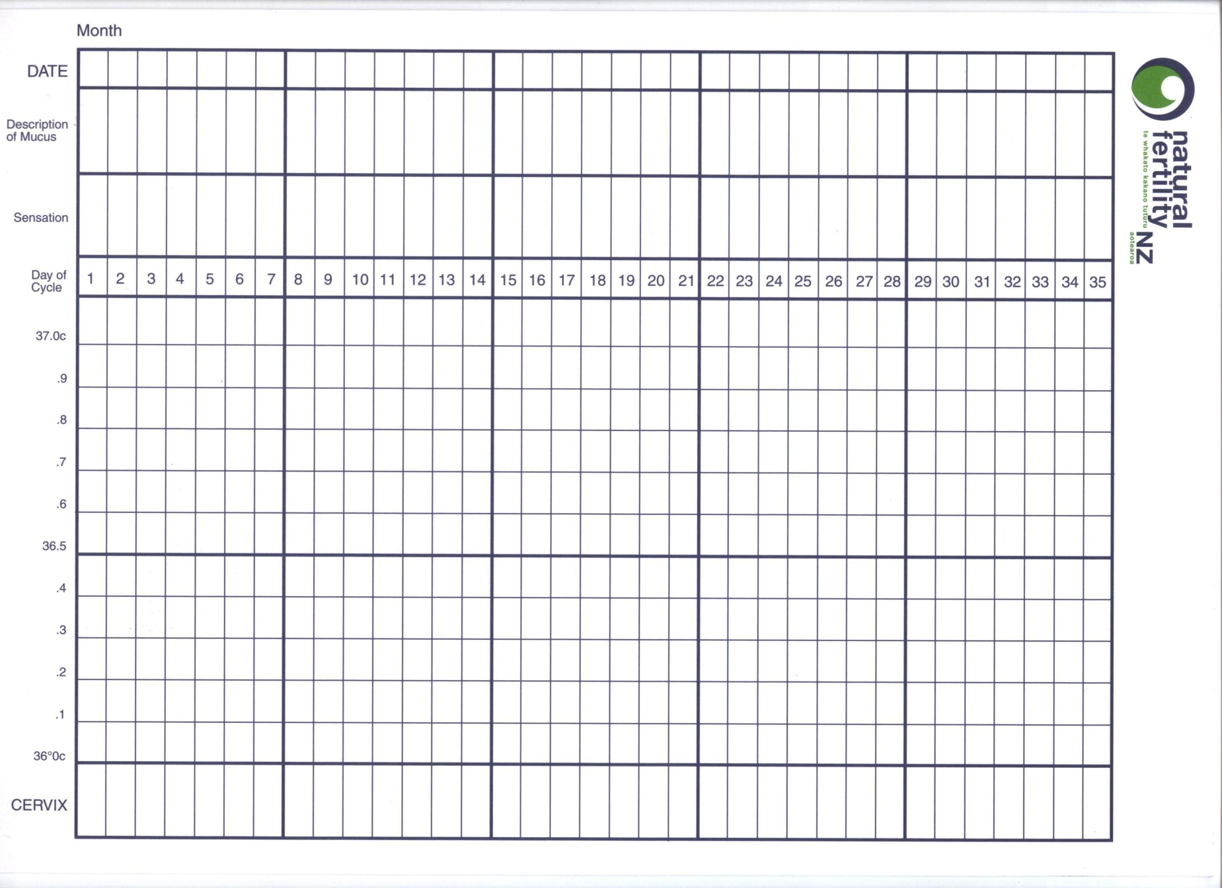
Notes:
This is what our Sympto-Thermal chart looks like. There is space to document the colour, amount and texture of mucus; vaginal sensation, basal body temperature and changes in the cervix. A woman will record these signs daily on her chart.

Slide 33
What’s involved ?
A course of 3 appointments
1-1 with Fertility Educator
85% partners attend
Cost $200 - $300
Includes 3 face to face appointments, 3 monthly follow up phone calls for first year, charts and written information
www.naturalfertility.co.nz
Notes:
Read this slide. You may want to put in your own stats re partner attendance.

Slide 34
Requirements
Time to learn
Professional instruction and support of educator
Digital Thermometer
Motivation
Daily Charting
www.naturalfertility.co.nz
Notes:
Read the requirements as listed.

Slide 35
Notes:
Here’s an example of a client’s chart who is using the information to help them avoid pregnancy. They have a 30 day cycle and we know they have ovulated because we can see a temperature rise which is sustained till the next period starts. We can also see that she was producing a very fertile type mucus prior to releasing an egg (runny, stretchy, lots) with a fertile sensation of moist and wet. The time from when she ovulated to getting her next period was 15 days - this is in the normal range of 10-16.

Slide 36
Notes:
This chart is from a woman who is trying to conceive. She has marked intercourse with love hearts. She has ovulated (we can see a temperature rise), but her second phase length is on the short side - 9 days. We would want to keep an eye on this and see if it was a one off, or a regular occurring issue. It may need addressing. Fertile signs occur in sync with ovulation.

Slide 37
Notes:
This chart here shows the advantage of using the Sympto-Thermal method over other natural family planning methods. Sympto-Thermal is a double check method, requiring the the observing of two changes at the end of the cycle to mark the end of the fertile phase. This client has had her most fertile signs finish on day 15 but hasn’t ovulated until day 23 - what we call a delayed ovulation. Other natural family planning methods suggest that on the 4th evening of change from fertile to infertile descriptions this woman would be safe for unprotected intercourse. This would put her in the days just prior to ovulation occurring which have the greatest chances of conception.

Slide 38
Notes:
This chart shows this woman who was trying to conceive has been successful and has become pregnant. Without doing a pregnancy test, we know that if after ovulation, a woman has 18 high temperatures (higher than the previous six prior to ovulation), then she is pregnant. The act of intercourse on day 14 resulted in conception (conception is most likely to occur in the 24-48 hours before ovulation (temperature rise)).

Slide 39
Where do you see Natural Fertility NZ in this picture?
Specialist
Couple having problems
conceiving
Infertility Clinic
GP
www.naturalfertility.co.nz
Notes:
Ideally, off all these boxes we would like to see an arrow that points to NFNZ Educators. The arrows leading from the health professional groups would be double arrowed, reflecting the feedback we would give with the clients consent back to the referral agent.

Slide 40
Where do you see Natural Fertility NZ in this picture?
Specialist
Couple having problems
conceiving
Infertility Clinic
GP
NFNZ Fertility Educators
www.naturalfertility.co.nz
Notes:
This is how we would ideally like to see the process work.

Slide 41
Benefits of Fertility Awareness for the client
An understanding of their menstrual cycle
Able to recognise the signs and symptoms of fertility
Able to understand what these signs mean
The ability to determine, every cycle, the few days it is possible for the woman to conceive
Enables intercourse to be timed appropriately to
MAXIMISE THE CHANCES OF CONCEPTION
Recognition of peak fertility day enhances chances of pregnancy in couples
www.naturalfertility.co.nz
Notes:
‹#›
There are many benefits of learning Fertility Awareness. Read the list. For those who are unable to attend a clinic, there is a distance learning service available and consultations can occur using Skype.

Slide 42
Benefits for the client continued
Empowering
Reduces stress levels
Allows couples to be more in control and involved in their diagnosis and treatment
Supports a woman’s decision to breastfeed while giving contraceptive cover
A contraceptive method which works with the client's belief system
A shared approach to contraception
“I wish I’d known about this before!”
www.naturalfertility.co.nz
Notes:
Read bullet points

Slide 43
Review of Fertility Quiz
F Men are only fertile for about two weeks out of every month
F A woman who has irregular periods is less likely to get pregnant
F Sperm live for as long as it takes to meet the egg
F A woman cannot get pregnant if she has intercourse during her period
T Women are most likely to ovulate two weeks before their period
F After ovulation the woman’s egg lives for about 3 days
T After menopause, women don’t ovulate at all
T You can always tell when your next period is due if you know when you ovulated
T A woman can ovulate twice during her menstrual cycle
F If a woman is breastfeeding, she cannot get pregnant
Notes:
Give the answers to the quiz if you haven’t already done so. I often have chocolate to hand out for the top score(s) After the quiz answers are given, get some feedback from the group which you can then use on your own website/work facebook page and to meet any grant requirements (if you received a grant from NFNZ to deliver this session). This can be in the form of a simple tick yes/no sheet, hand it in and receive a chocolate as thanks for using a whiteboard, people can be invited to come up and write something new that they learnt in the session. Take a photo of this at the end of the session for your evaluation requirements.

Slide 44
BREASTFEEDING AND FERTILITY
Notes:
This section of slides is about Breastfeeding and Fertility. Remember to liaise with the person who has contacted you about the session to determine the depth of the session required and potential attendee knowledge and backgrounds.

Slide 45
Facts
Breastfeeding does not prevent pregnancy
Breastfeeding can delay the return of menstruation and ovulation
Natural Family Planning is the only form of contraception that promotes breastfeeding
www.naturalfertility.co.nz
Notes:
Here are some facts about breastfeeding and fertility.
Breastfeeding does not prevent pregnancy. We have all heard stories of people who said I got pregnant while breastfeeding - it is entirely possible.
Breastfeeding, under very specific conditions can delay the return of a woman’s period and ovulation.
Natural Family Planning and breastfeeding work well together. Working with the signs your body gives you, does not interfere with the production or secretion of breast milk.

Slide 46
Bellagio Consensus Conference on Lactational Infertility 1988
Question was raised “Under what conditions does breastfeeding delay the return of fertility?”
The consensus was:
“That the maximum birth spacing effect of breastfeeding is achieved when a mother “fully” or nearly fully breastfeeds and remains amenorrhoeic (bleeding before the 56th postpartum day being ignored).
When these 2 conditions are fulfilled, breastfeeding provides more than 98% protection from pregnancy in the first six months.
At six months, or if menses return, or if breastfeeding ceases to be full or nearly full before the sixth month, the risk of pregnancy increases.”
www.naturalfertility.co.nz
Notes:
‹#›
Back in the 80s, a group of health professionals from around the world, with an interest in breastfeeding and fertility, got together to discuss the idea that breastfeeding seemed to delay the return of a woman’s fertility. They each returned to their own countries to carry out an agreed research project. They then reconvened in Bellagio, Italy to analyse the data they had collected. From this came the Bellagio Consensus which is outlined here. The question that was raised was…. (read the slide)

Slide 47
Breastfeeding Mechanism
Notes:
These slideshow how breastfeeding affects fertility. If a baby is fully breastfed, the suckling at the breast is enough to suppress ovarian activity due to a high level of the hormone prolactin. When a baby is breastfed and receiving other foods or fluids, the message from the baby suckling at the breast is not so strong and the ovaries start to receive messages to start maturing eggs. This is then followed by ovulation and a period.
‹#›

Slide 48
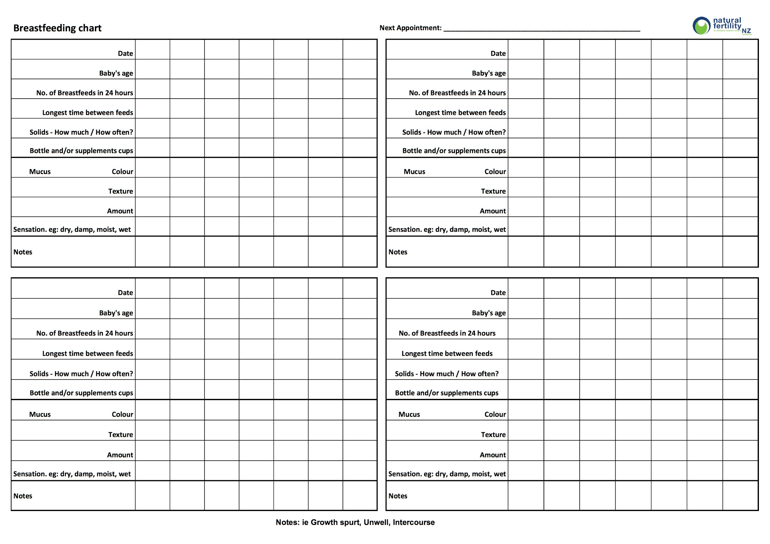
Breastfeeding Chart
Notes:
If a woman doesn’t meet the criteria to use LAM or chooses to chart, this is the chart she would use. It requires documentation of: age of baby, number of breastfeeds in 24 hours, baby longest sleep, amount of food or fluids given, descriptions of mucus, sensation and other comments. If the client is to use breastfeeding charting, they are taught how to fill in the chart, and return to the clinic after two-three weeks or recording the information required. By this time a basic infertile pattern should be able to be seen.
‹#›

Slide 49
Example of Breastfeeding Chart
Notes:
Here is an example of a chart that has been filled in for four weeks. The pattern we can see overall is dryness and no mucus. We would then teach the woman when she is safe to have unprotected intercourse (we call these guidelines). A woman can continue to use this charting and follow these guidelines till either her period returns or her baby is 6 months old.

Slide 50
Returning to Fertility Chart
Notes:
At six months of age, if periods haven’t returned, we switch the client to a new chart, which involves taking temperature everyday on waking (as well as the other information previously recorded). Temperature will give us an indicator of how far away the first period is going to be. Most women who fully breastfeed to six months will have their first period return between 8-9 months postpartum. It is important to know that the older a baby is, the more likely it will be that a woman will ovulate before her first period appears. So don’t think you are safe until your first period returns because this may not be the case. You can see why it is so important to be working with an experienced Fertility Educator, who can guide you through this transition phase. Once periods return, the client is moved to a Sympto-Thermal chart.

Slide 51
Example of Returning to Fertility Chart
Notes:
Here is an example of a chart that is used once a baby is six months of age. The mum has filled in four weeks of information. Initially the pattern is dry with no mucus, but near the end of the four weeks she is seeing more fertile mucus and has a sensation of wetness. Her temperature is fairly stable. All of this indicates that fertility is not far off from returning, meaning she should get a period in the next few weeks.

Slide 52
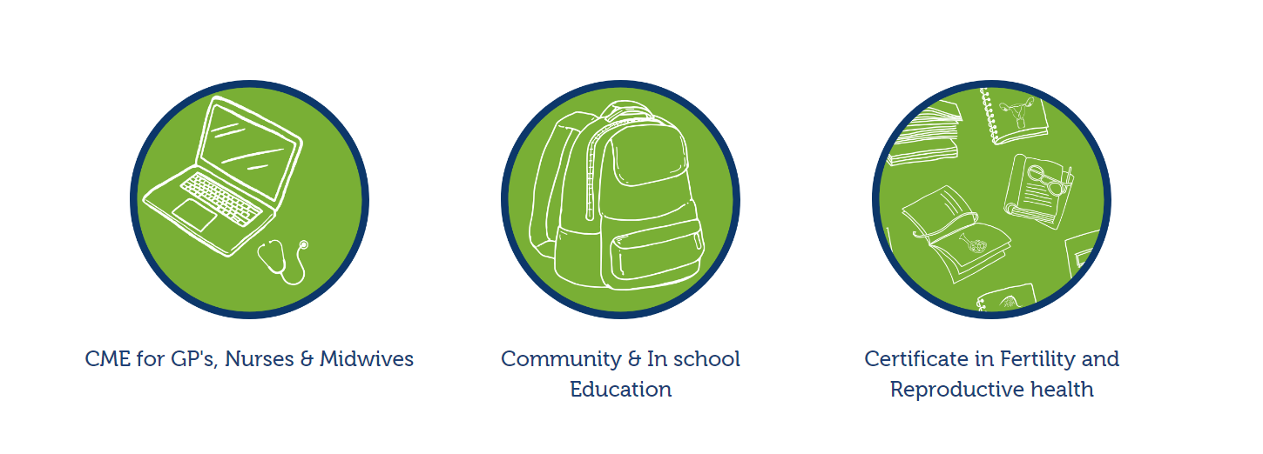
NFNZ Education
Notes:
NFNZ Fertility Educators provide education to a number of groups which include health professionals
and community groups as well as training Fertility Educators. We now also provide CME education Online.

Slide 53
Fertility Educator Training Programme
Only training provider in NZ
10 month year course
Mainly distance learning
Two four day practicums
Interval of supervised practice
Ongoing clinical support and random audits
Notes:
‹#›
Natural Fertility NZ runs a Fertility Educator Training Programme and is the only provider of this training in NZ.
It is a programme that is designed to be started and completed in a year.
Mainly done through distance learning with two four day practical blocks, usually held in Christchurch/Auckland.
Following completion of the theory and practical components of the course, students move into a phase of supervised practice over two-three months.
On completion of the programme, students are qualified as a Fertility Educator through Natural Fertility NZ and can use this information in their current practice as a nurse, naturopath, homeopath, medical herbalist, doctor, midwife, lactation consultant, acupuncturist etc.
Fertility Educators have ongoing clinical support through NFNZs Clinical Supervisor and are subject to audits to maintain proficiency and enable best practice.

Slide 54
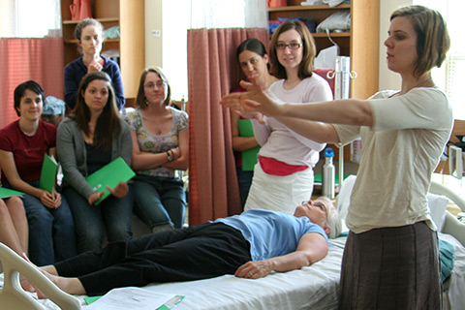
Education for Health Professionals
We offer courses approved by:
RNZCGPs for GPs
Midwifery Council for Midwives
Family Planning for Nurses
5th year Medical Students
Notes:
Fertility Awareness information is also valuable to health professionals. As mentioned earlier, we offer courses approved by the RNZCGPs and Midwifery Council for GPs, Nurses and Midwives. In certain circumstances, these sessions can be provided free of charge.

Slide 55
Education in the Community
Interested community groups
Antenatal groups
Postnatal groups
Schools
puberty, contraception, valuing fertility, sexual health
Notes:
Fertility Educators are also able to offer education to various community groups on various subjects.

Slide 56
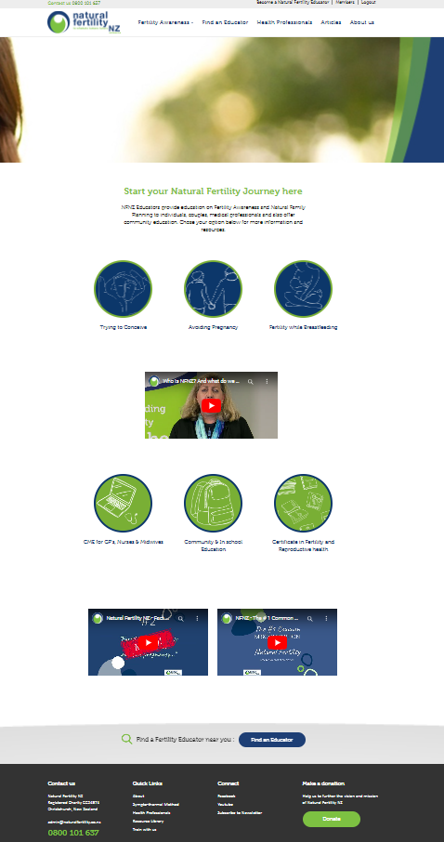
For Further Information
visit our website
www.naturalfertility.co.nz
Notes:
That concludes today’s session. If you would like further information, visit our website or you can contact me ……. (add in your own website, email and phone number)
‹#›

