Slide 1
Avoiding Conception
3rd Appointment - Insert your clients name

Slide 2
Session Overview
Objectives:
That you can interpret your chart independently
That you can mark up your chart correctly
Consultation 3
Notes:
Give overview of session

Slide 3
Contract
Follow up from consultation 2
Consultation 3
Notes:
Have the client agree to session objectives
Educator to follow up on issues raised from second appointment if any

Slide 4
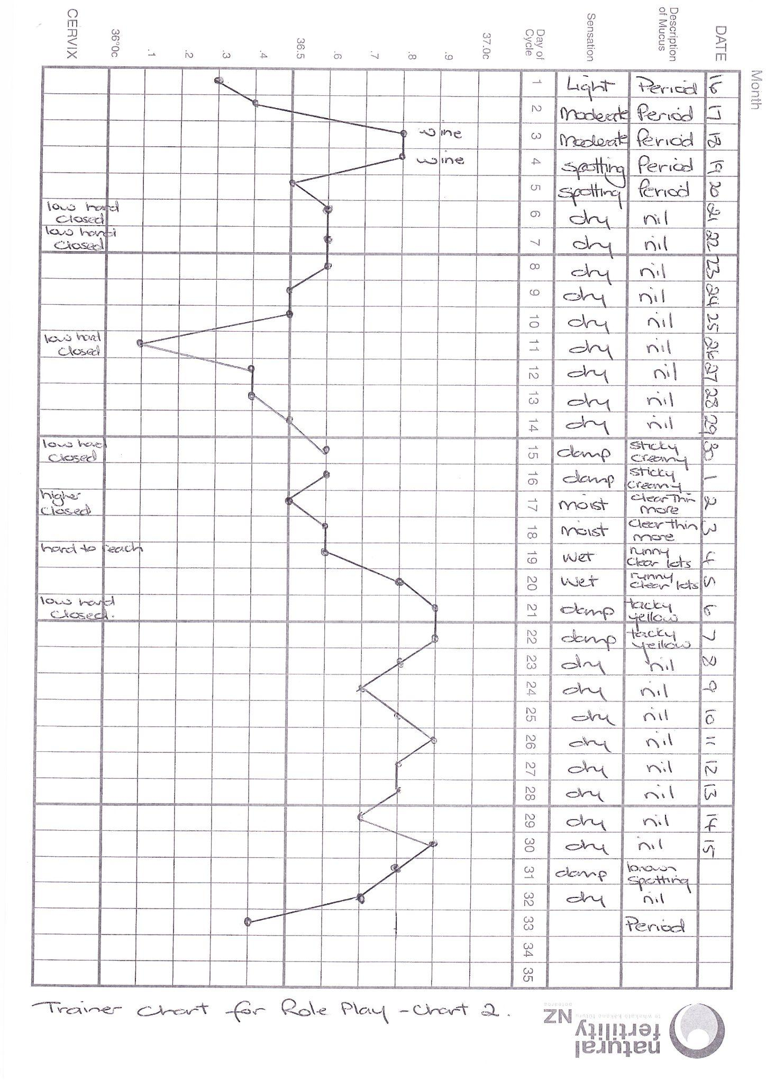
Notes:
Go through your chart check

Slide 5
Where has fertility started in this cycle?
S-21 calculation?
Where was the client safe at the beginning of the cycle?
Further along in the cycle where is there a change from your fertile mucus and sensation to a lesser fertile description?
Where would you place the X?
And the three count after the X?
Insert your clients chart and rotate to portrait to make it easier to read
Notes:
Get the client to apply the pre ov and post ov guidelines if not already done

Slide 6
Mark in the 3 temperatures which are higher than the previous 6
How does that coincide with the X for mucus/sensation?
From what evening are you safe to have intercourse from?
What is the cycle length?
What is the luteal length (from ovulation to day before next period begins)?
Insert your clients chart
Notes:
Get the client to identify and mark on the chart temp rise, luteal length, cycle length and carry over the X from the previous slide.

Slide 7
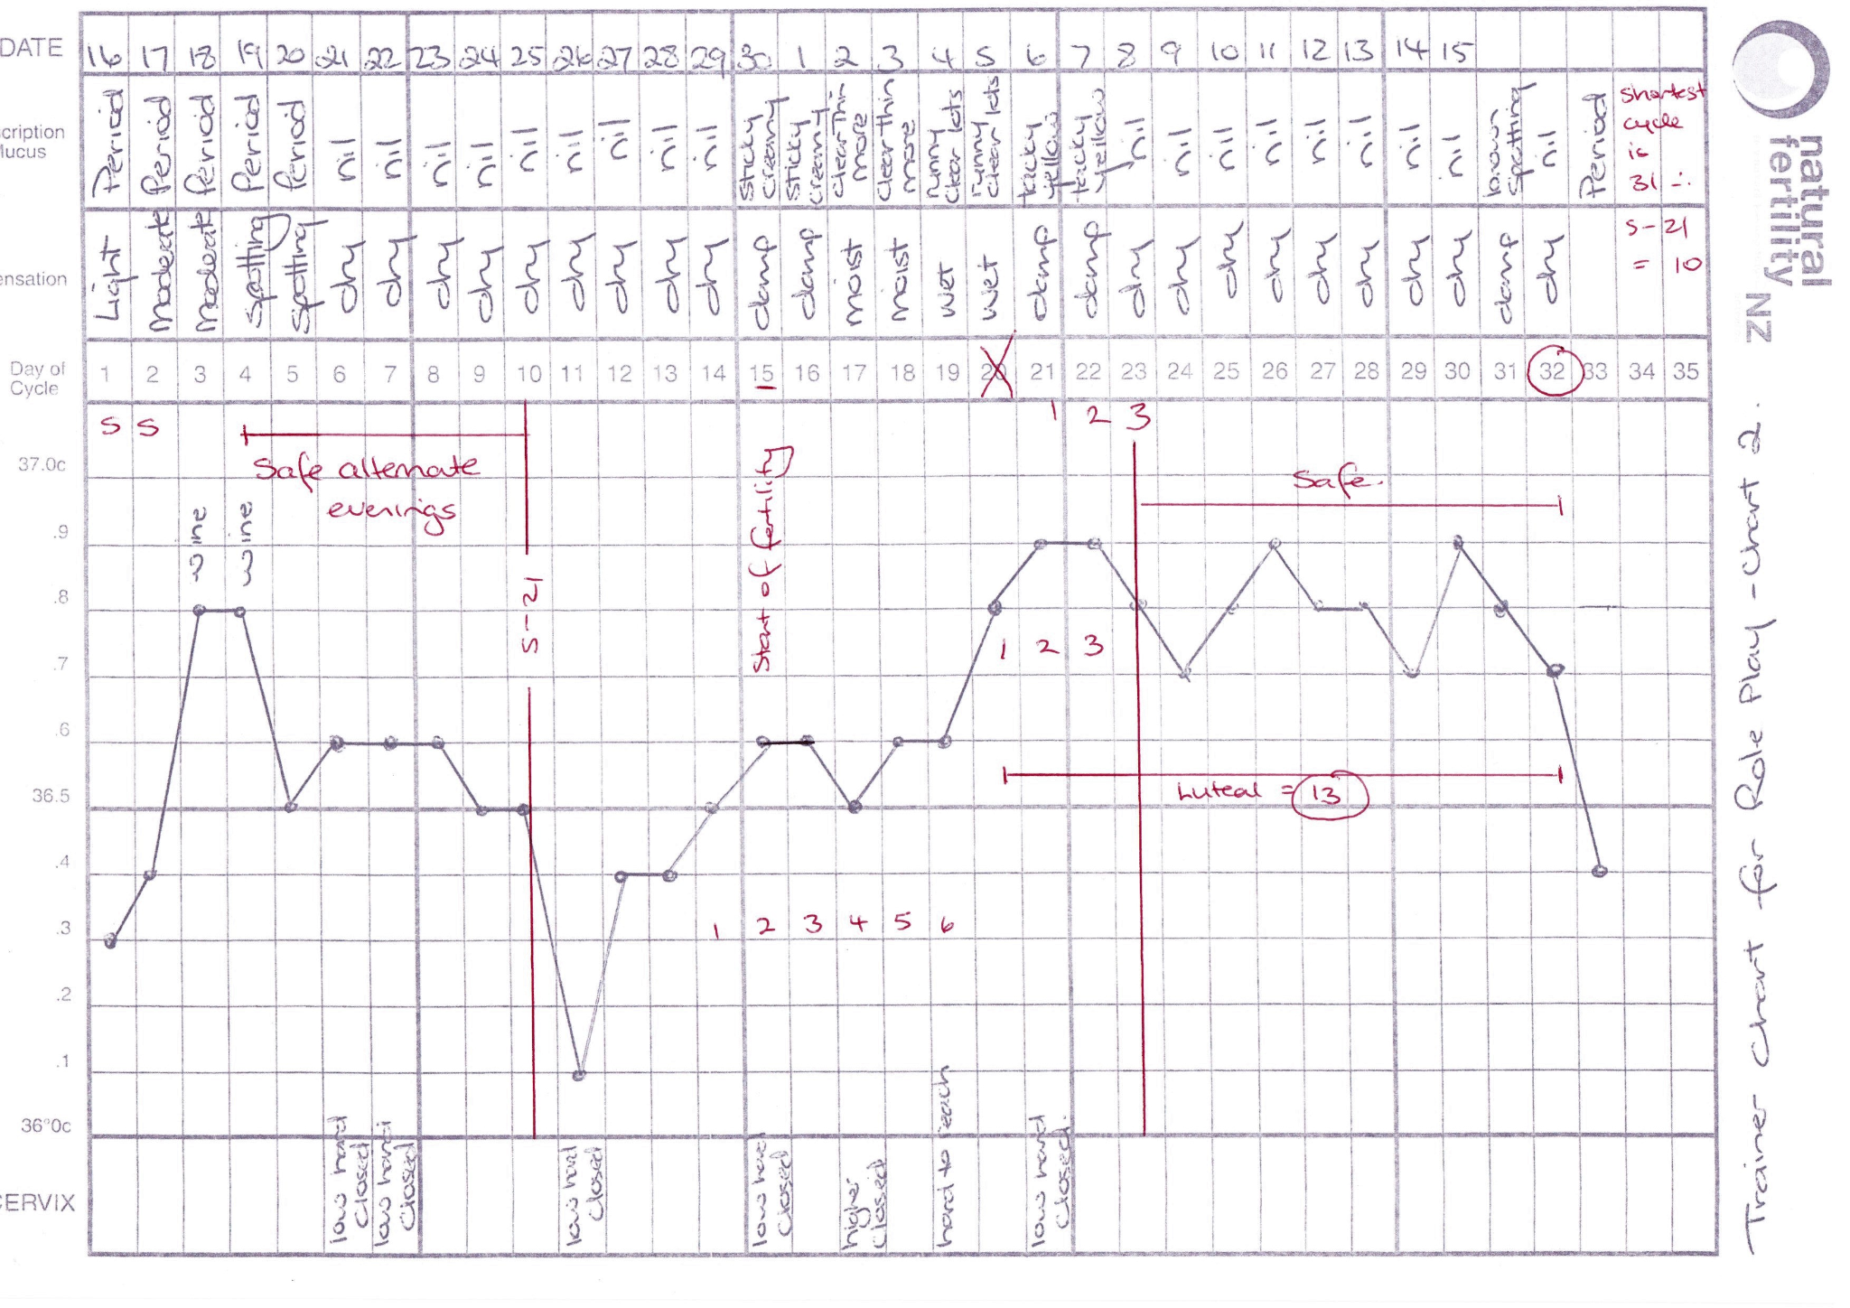
Replace this chart with your clients chart that has been marked up by you.
Notes:
Add in the correctly marked up chart

Slide 8
What’s next
Autonomous or need for a further appointment
3 monthly contact by educator up to a year from first appointment
Contact if any questions
Notes:
Remember to complete your case notes, NFNZ stats, end of course letter to GP and referral person if a health professional.
Diarise your 3 monthly contact dates

Slide 9
Reference Slides

Slide 10
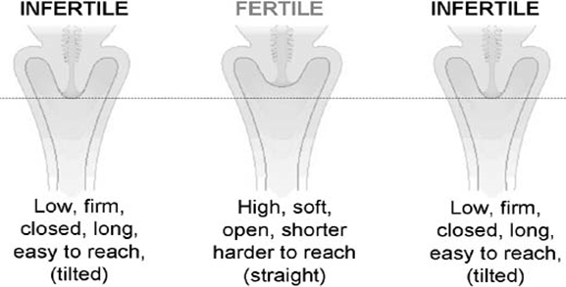
Another Fertility Sign - Changes in the Cervix
Source: https://www.glowm.com/section-view/heading/fertility-awareness-methods-of-family-planning-for-achieving-or-avoiding-pregnancy/item/383
Notes:
Explain how to perform cervical palpation and how to record
Why Chart?
Changes which occur in the cervix during the menstrual cycle can be recognised by feeling your cervix with your fingers (called Cervical Palpation).
For many women cervical palpation gives them useful backup information in identifying the beginning and end of the fertile phase.
This is a useful additional check when a woman observes very little mucus.
When should I check my cervix?
Wait for your period to finish.
Check the cervix about the same time every day, but not immediately after getting up in the morning or after a bowel motion. In the evening or in the shower are good times. You only need to check your cervix once a day.
How do I observe changes in the Cervix?
Insert one or two fingers into your vagina. A normal standing position, a slight squat or with one leg raised on a chair (rather like inserting a tampon) is recommended. Use the same position every day to check your cervix.
What should I observe?
Position - is the cervix low, raised or in between?
Feel- is it firm (like the tip of your nose) or soft (like your lips)?
Opening- is it open or closed?
Tilt- is it back, front or up? (Don’t worry if you find tilt more difficult to
observe).
During the fertile phase (4 - 5 days before ovulation) the cervix can be:
● Higher in the vagina
● Softer to feel
● More open at the dimple felt at the entrance to the cervix

