Slide 1
Avoiding Conception
2nd Appointment - Insert client name

Slide 2
Session Overview
Objectives:
Learn how to identify the end of fertility
Learn how to identify the start of fertility
Learn about another sign of fertility - changes in the cervix
Consultation 2
Notes:
Give overview of session

Slide 3
Contract
Follow up from consultation 1
Consultation 2
Notes:
Have the client agree to session objectives
Educator to follow up on issues raised from first appointment

Slide 4
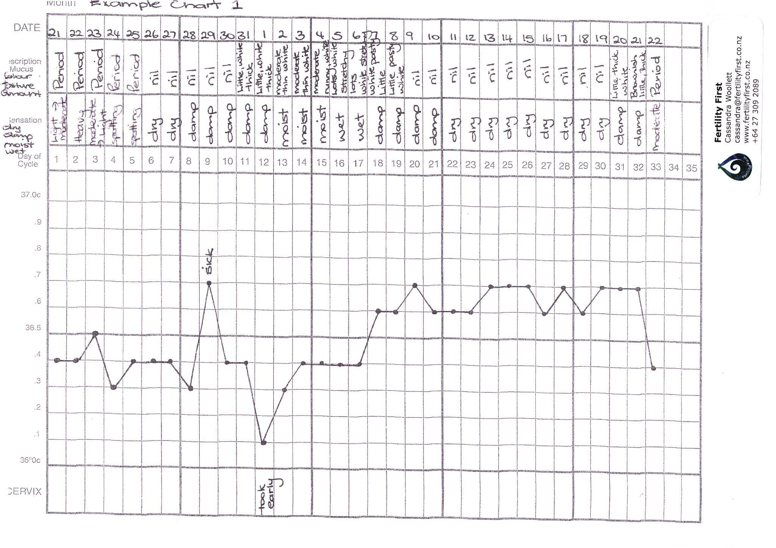
Insert your clients chart in here and remove this one
Notes:
This is when you chart check. Ask how they observed their mucus, how about sensation, how did they take their temperature. Ask for clarification about anything written on the chart.

Slide 5
Insert your clients chart and rotate to make it easier to read
Notes:
Now work through with the client the descriptions they have made for mucus and sensation.

Slide 6
Establishing the end of fertility in a cycle
Change from fertile mucus and sensation to a less fertile description
Temperature rise - indicating ovulation has occurred
Length of second phase of cycle
Cycle length
Application of guidelines

Slide 7
Insert your clients chart in portrait
Which mucus description do you think had the most fluid content? Or which texture would be the easiest for sperm to move through?
And what about sensation?
We mark this day of the cycle with an X to indicate last fertile day
Notes:
Now work through with the client the descriptions they have made for mucus and sensation.
Ask they client which description had the most water content.

Slide 8
Where has the temperature rise occurred? On what day of the cycle?
How does intercourse match up with fertile phase?
Insert your own clients chart
Length of second phase of cycle
Cycle length
Notes:
Teach how to identify ovulation. 3 over 6 and sustained.
Has intercourse been in the fertile phase?
Teach about luteal phase and its importance.
Check cycle length

Slide 9
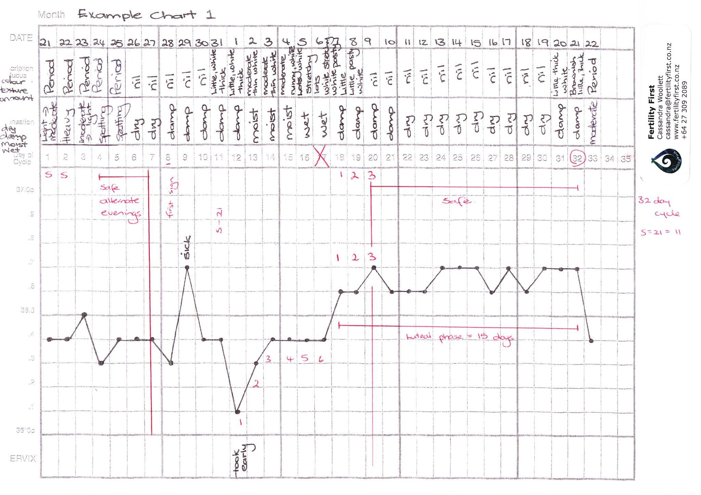
Insert your clients chart marked up with the post ov guidelines only applied by you
Notes:
Add a chart with the post ov guidelines applied.

Slide 10
Start of Fertility
Looking for the first sign of any fertility which is marked by any mucus or a sensation that is not dry.
What day of the cycle do you see this?
Insert your own clients chart in portrait

Slide 11
S-21
Safe time at the beginning of the cycle
Insert your clients chart in here and remove this one
Notes:
Do the calculation with the client.
Add in the vertical line indicating end of infertile phase and start of the fertile phase.
Teach safe days 1 and 2 then alternate evernings until vertical line occurs (inclusive of that evening)

Slide 12
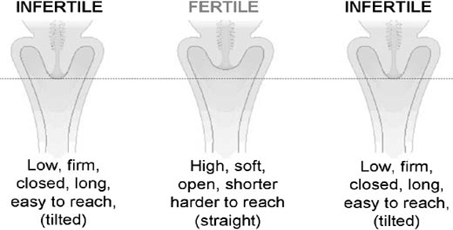
Another Fertility Sign - Changes in the Cervix
Source: https://www.glowm.com/section-view/heading/fertility-awareness-methods-of-family-planning-for-achieving-or-avoiding-pregnancy/item/383
Notes:
Explain how to perform cervical palpation and how to record
Why Chart?
Changes which occur in the cervix during the menstrual cycle can be recognised by feeling your cervix with your fingers (called Cervical Palpation).
For many women cervical palpation gives them useful backup information in identifying the beginning and end of the fertile phase.
This is a useful additional check when a woman observes very little mucus.
When should I check my cervix?
Wait for your period to finish.
Check the cervix about the same time every day, but not immediately after getting up in the morning or after a bowel motion. In the evening or in the shower are good times. You only need to check your cervix once a day.
How do I observe changes in the Cervix?
Insert one or two fingers into your vagina. A normal standing position, a slight squat or with one leg raised on a chair (rather like inserting a tampon) is recommended. Use the same position every day to check your cervix.
What should I observe?
Position - is the cervix low, raised or in between?
Feel- is it firm (like the tip of your nose) or soft (like your lips)?
Opening- is it open or closed?
Tilt- is it back, front or up? (Don’t worry if you find tilt more difficult to
observe).
During the fertile phase (4 - 5 days before ovulation) the cervix can be:
● Higher in the vagina
● Softer to feel
● More open at the dimple felt at the entrance to the cervix

Slide 13
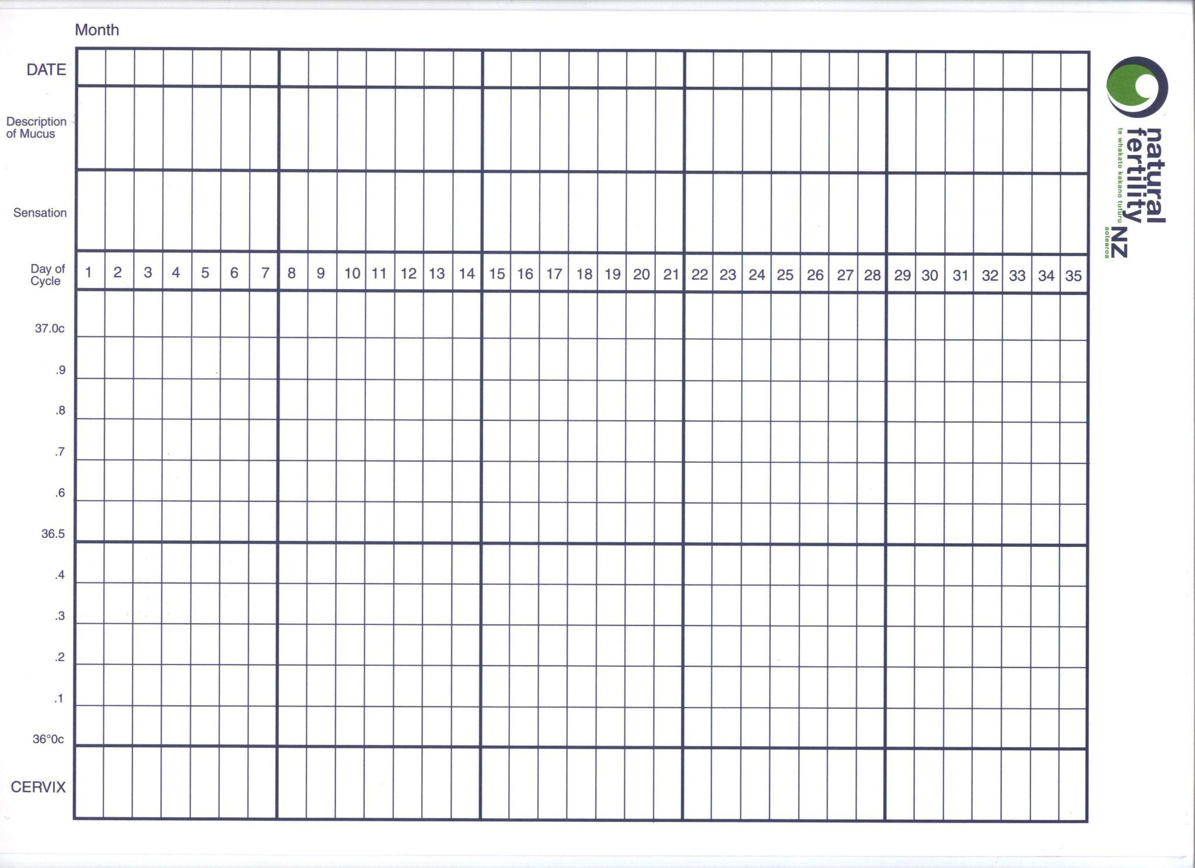
Where to record changes in the cervix
Soft/Hard
Low/High
Open/Closed
Notes:
Can narrate or draw

Slide 14
What we learnt today and what’s next
Learnt how to identify the start and end of fertility and how to mark this on a chart
Learnt about changes in the cervix and how to record this
Been given advice on protected or unprotected intercourse.
Book 3rd appointment
Objectives of 3rd appt reviewed
Present at next appointment with guidelines recorded on chart
Contact if any questions

