Slide 1
Avoiding Conception
1st Appointment - Put your clients name here

Slide 2
Course Overview
Consultation 1
Consultation 2
Consultation 3
3 Consultations via Zoom
Notes:
Give overview of course
Explain each session

Slide 3
Contract
Client
Educator
Notes:
Client responsibilities: observe signs of fertility daily and record, take temperature daily and record, action to do list, contact educator if any questions, attend all appointments, advance notice if not able to come to appointment.
Educator - provide teaching as explained in each session, answer questions, privacy and confidentiality, follow up on what I say I will.

Slide 4
Client History
Female
Male
Notes:
Basics on client record card, then smears, diet, last menstrual period, prior use of contraceptives, current contraceptive use, lifestyle, exercise, general health, management of periods.

Slide 5
Anatomy and Physiology

Slide 6
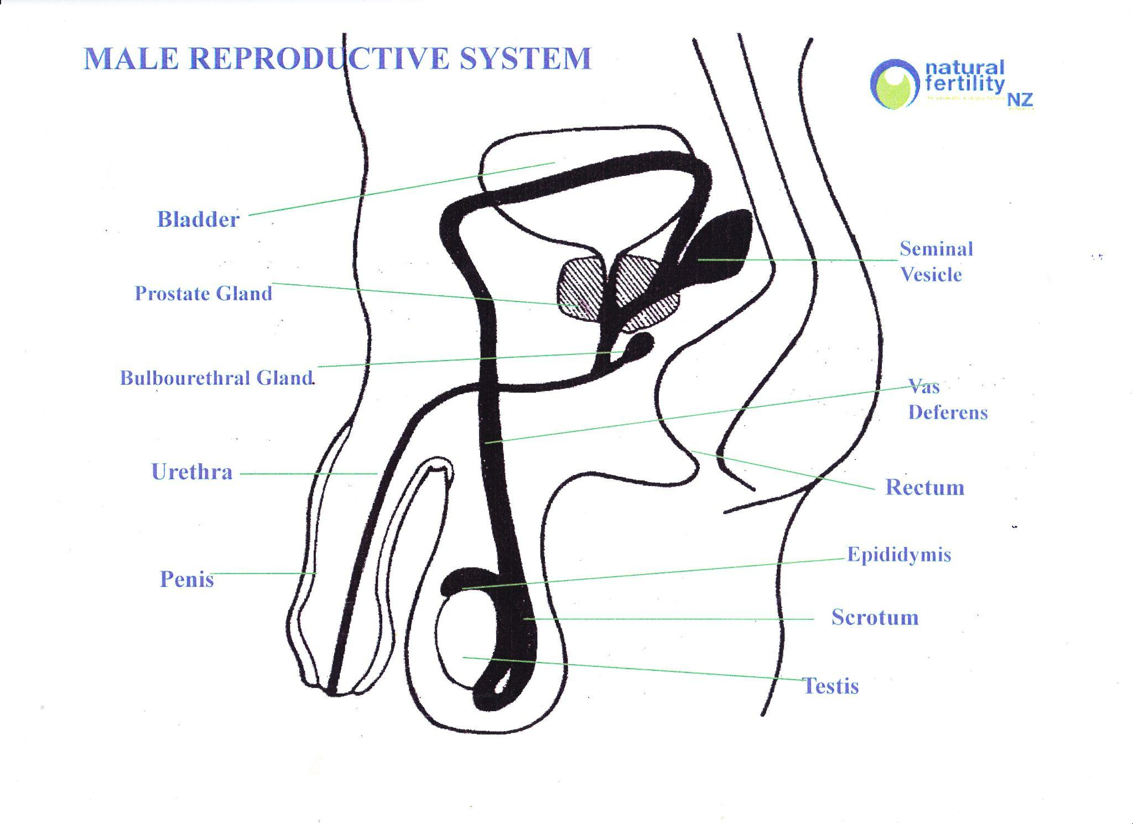
Male Reproductive System

Slide 7
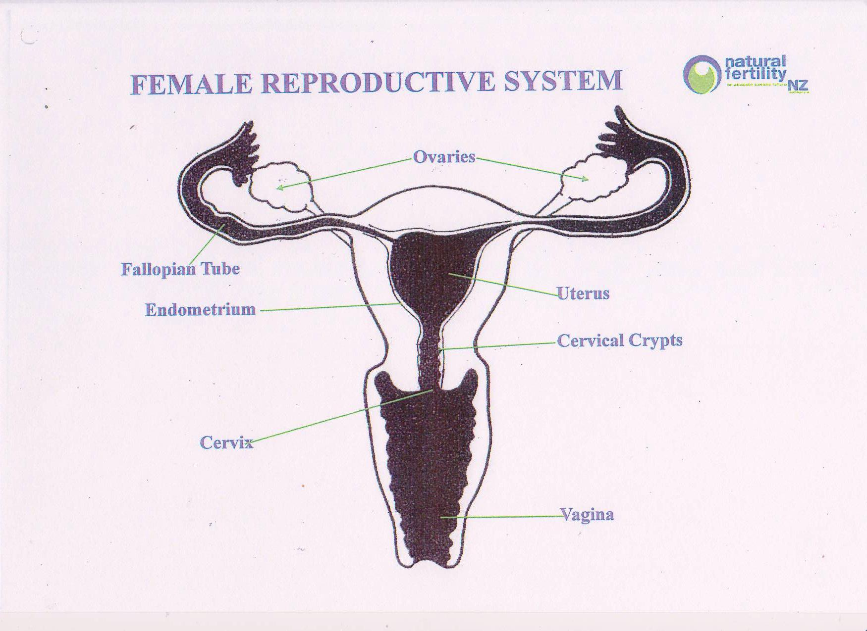
Female Reproductive System

Slide 8
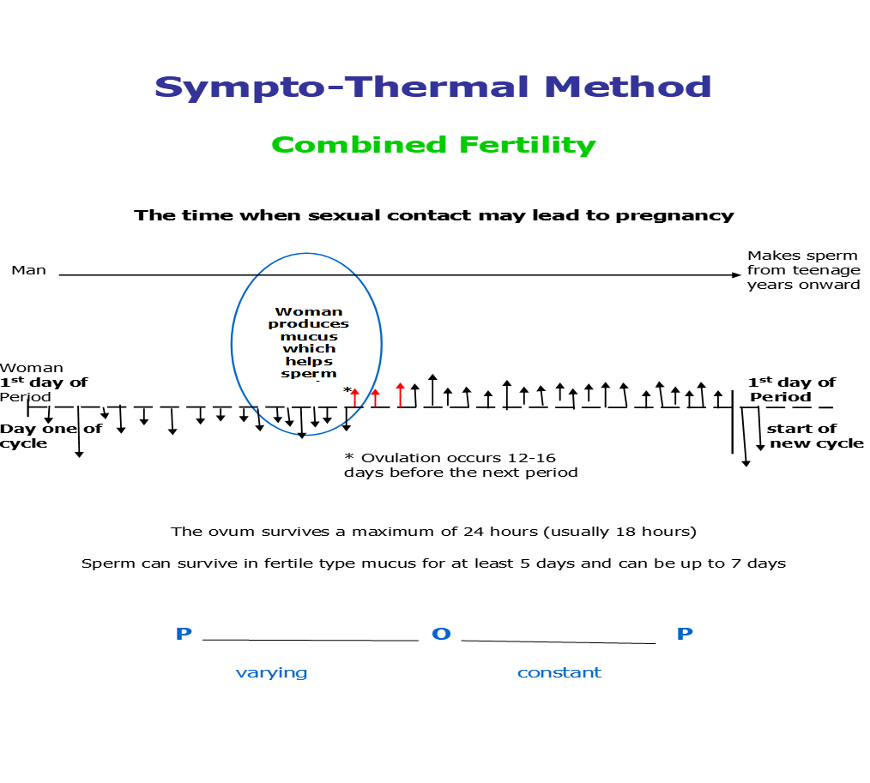
Sympto-Thermal Method
Combined Fertility

Slide 9
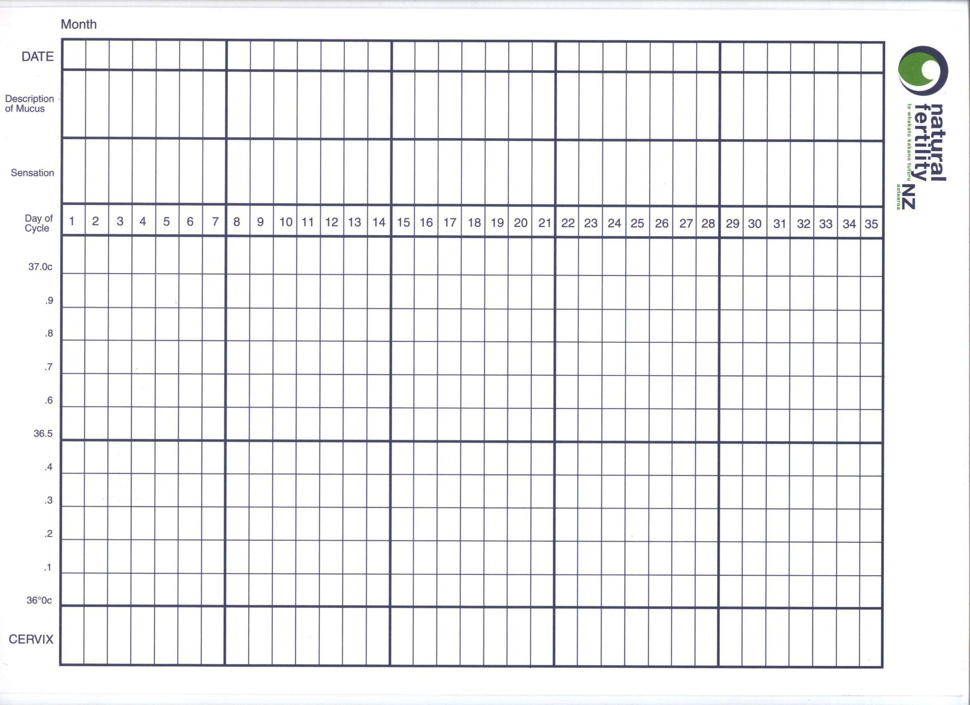
Charting

Slide 11
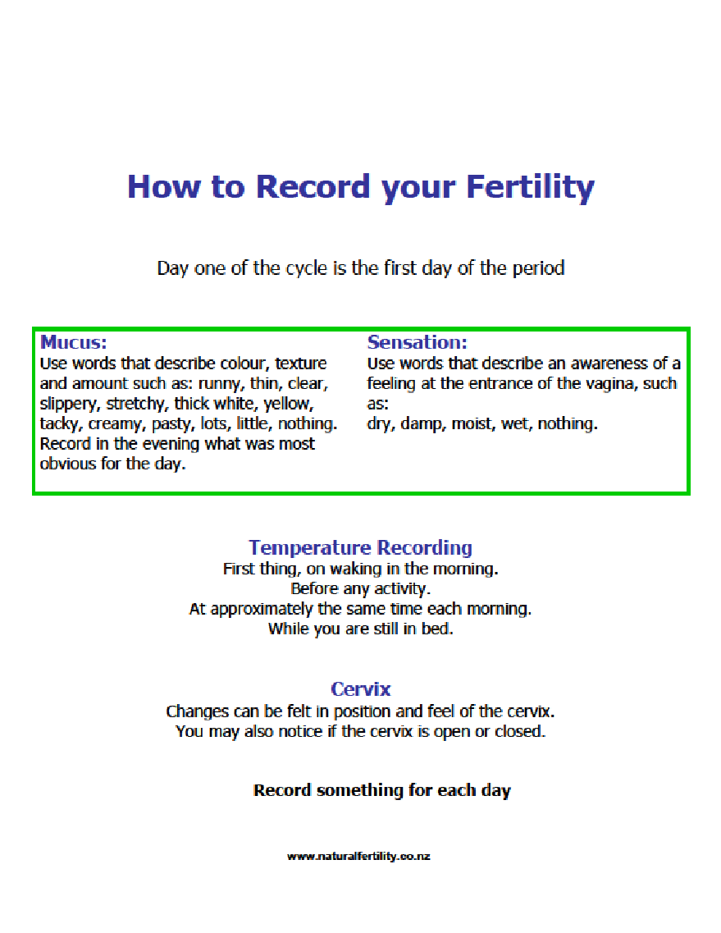
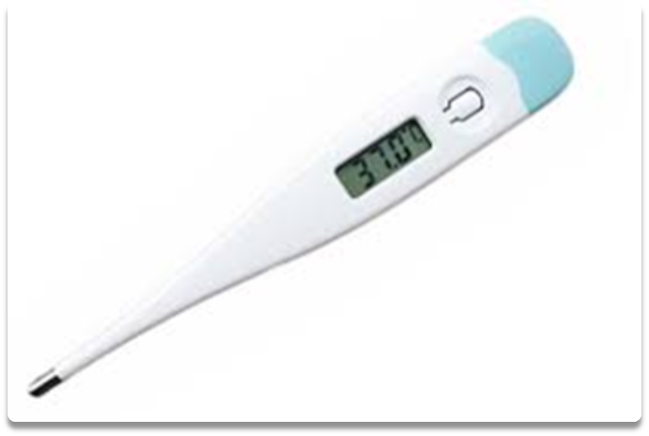

Slide 13
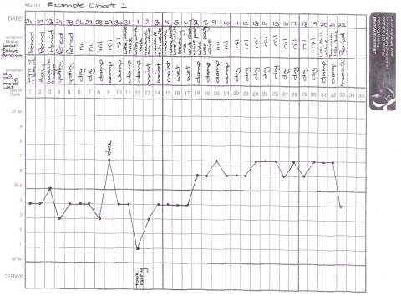
You can use this or any other example chart

Slide 14
Review
How are you going to fill in your chart?

Slide 15
What’s next
Next contact
Next appointment
To Do List
Payment
Notes:
Remember to document everything, complete your NFNZ stats, diarise next appointment, send Zoom invite if appropriate, follow up on anything you promised to do. If you advised no unprotected intercourse, make sure you document it in your notes.

